Slide 1
Design principles
Shubheksha Adhikari

Slide 2
Introduction
set of values that act as a compass for the product
helps to keep the entire team on the same path throughout the design process
should be specific, nuanced, and actionable
refer as value statements that describe the most important goals that a product or service should deliver for users and are used to frame design decisions
also helps to make decisions that upholds integrity of values
They may be universal design principles or specific design principles
Universal design principles are more general laws of design which helps define how users behave regardless of the specific context
Specific design principles is that which helps define how users behave in specific context. It brings user experience vision to life in a way that is unique to the mission and user base.

Slide 3
Principles of Design
Contrast:
It is used to create focal points and variety using opposite elements in color, shape, style, texture, etc. Here, contrast may be high or low as per required. High contrast is when two subjects are completely or nearly opposite from one another, such as the colors red and green, or a smooth texture and a rough texture. Low contrast is when two subjects are very similar or the same, such as a circle and an oval, or two slightly different shades of blue.

Slide 4
Balance:
It is called visual weighting, where all the “weight” within a piece is, well, balanced! The objects are placed around a scene so that there isn’t too much empty space, or that objects feel evenly spaced. There is symmetric and asymmetric balanced on the basis of centered lines.
Emphasis:
It is the element within the scene that your eyes tend to go to first. It is done with space, proportions, color and etc. It causes certain elements to stand out among all others

Slide 5
Movement:
It affects how the viewer looks at a piece. We can arrange sections of a scene to dictate how a viewer’s eyes will travel across it where important leads to next more important ones
Hierarchy:
It refers to importance of elements within a design. The most important elements should appear to be the most important and vice versa

Slide 6
Repetition:
It is repeated elements within a piece which bring a sense of cohesiveness to the illustration as a whole. It tends to create patterns within element with the help of rhythm and unity. Generally reinforcing idea or perception is repetition i.e. using same format, color, style.
Pattern:
It can refer to repetition of design elements. They can also set standards for how certain elements are designed

Slide 7
Rhythm:
It is somewhat similar to repetition, but blends movement in as well to create patterns where patterns can be structured or random, depending on requirement. For instance, a checkerboard has regular rhythm, because the pattern is identical and repeated. A crowd of people has random rhythm because no two people are the same, but the large number of people within the piece still holds rhythm. It is spacing between elements create rhythm which crates variety of emotions like calmness, excitement
White space:
It is area of design that have no design element. It is important for making decision uncluttered, as well as making various element stand out

Slide 8
Variety:
It creates visual interest in a design. It can be created via topography, color, images, textures and virtually other design element. It prevents design from becoming monotonous or boring
Unity:
It is how well elements of design work together and also gives clear visual relationship for communicate clear message

Slide 9
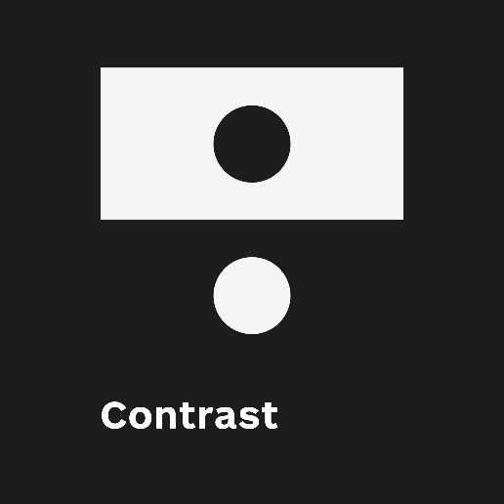
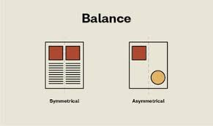
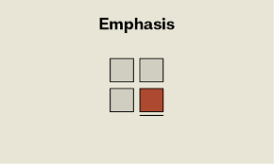
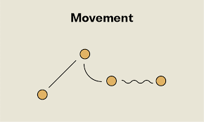
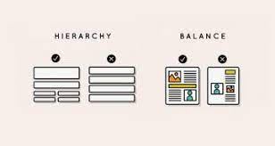
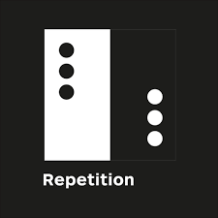
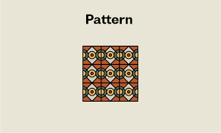
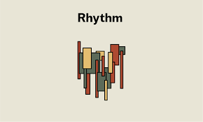
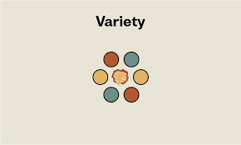

Slide 10
Steps for Effective Design Principles
Take a stand on which values are important
Be concise
Be memorable
Not conflict with one another
Inspire empathy

